Slide 1
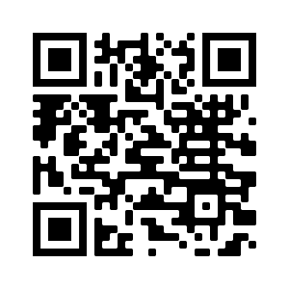
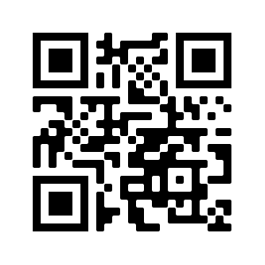
Post Vaccine Information
Post Vaccine Information
Your monitoring time ends: __________
Notify us immediately if you feel closing of the throat, wheezing, shortness of breath, upset stomach, dizziness or lightheadedness, itching, hives or swelling of the lips, face, or throat.
Read about your vaccine. Pfizer BioNTech Fact Sheet. Aim your smartphone’s camera at this code.
Before you leave, schedule your 2nd dose
on or after: __________ Aim your
smartphone’s camera at this code.
Sign up for V-Safe, and after vaccination health checker provided by CDC Aim your smart phone’s camera at this code.
Your monitoring time ends: __________
Notify us immediately if you feel closing of the throat, wheezing, shortness of breath, upset stomach, dizziness or lightheadedness, itching, hives or swelling of the lips, face, or throat.
Read about your vaccine. Pfizer BioNTech Fact Sheet. Aim your smartphone’s camera at this code.
Before you leave, schedule your 2nd dose
on or after: __________ Aim your
smartphone’s camera at this code.
Sign up for V-Safe, and after vaccination health checker provided by CDC Aim your smart phone’s camera at this code.
Post Vaccine Information
Post Vaccine Information
Your monitoring time ends: __________
Notify us immediately if you feel closing of the throat, wheezing, shortness of breath, upset stomach, dizziness or lightheadedness, itching, hives or swelling of the lips, face, or throat.
Read about your vaccine. Pfizer BioNTech Fact Sheet. Aim your smartphone’s camera at this code.
Before you leave, schedule your 2nd dose
on or after: __________ Aim your
smartphone’s camera at this code.
Sign up for V-Safe, and after vaccination health checker provided by CDC Aim your smart phone’s camera at this code.
Your monitoring time ends: __________
Notify us immediately if you feel closing of the throat, wheezing, shortness of breath, upset stomach, dizziness or lightheadedness, itching, hives or swelling of the lips, face, or throat.
Read about your vaccine. Pfizer BioNTech Fact Sheet. Aim your smartphone’s camera at this code.
Before you leave, schedule your 2nd dose
on or after: __________ Aim your
smartphone’s camera at this code.
Sign up for V-Safe, and after vaccination health checker provided by CDC Aim your smart phone’s camera at this code.

